Slide 1





Missouri Commuter Analysis
Martin Carriel, Addison Pietroburgo, Joshua Steinmetz, Scott Stevener
Washington University Data Analytics Boot Camp
Fall 2018

Slide 2
Motivation & Summary
Hypotheses
H0 = No differences exist between commuting types in metro versus rural counties across Missouri.
H1 = Differences exist between commuting types in metro versus rural counties across Missouri, where usage of public transit in metro counties is higher.
Our Questions
How do Missourians commute?
What differences exist for commuting types across counties in Missouri?
What differences exist for commuting types within metropolitan areas in Missouri?

Slide 3
Questions & Data
What kinds of data were needed?
Missouri-wide commuting data at the county level
Defined Metropolitan Statistical Areas (MSAs) for Missouri
Geocoordinates for each county
Data sources
US Census API
Wikipedia
Wikilou.com
MARC.org (Mid-America Regional Council)
Google Maps Geocode API

Slide 4
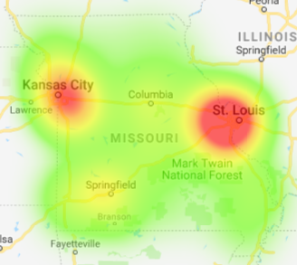
Data Exploration & Cleanup
Used census wrapper to make API calls to get commuter data for each county in MO
Calculated commuter type %s
Made calls to the Google Maps Geocode API to get coordinates for each county
Created heat map of commuter concentrations
Looked up counties in STL, KC and Springfield MSAs and repeated process for counties outside of MO

Slide 5
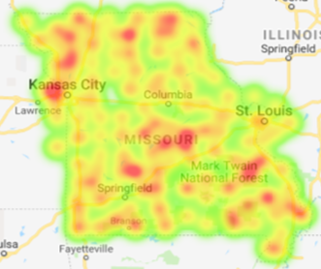
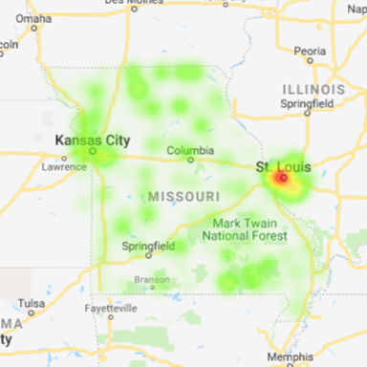
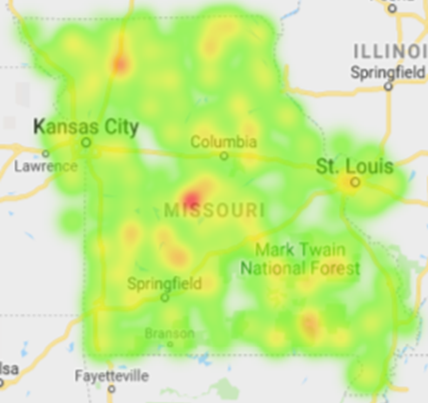
Data Analysis: Commute Type Concentrations in MO
Carpooler %
(max. 19%)
- Kansas City
- Jefferson City
- Farmington
Public Transit %
(max. 10%)
- St. Louis
Other Transit %
(max. 5%)
- Ozarks

Slide 6
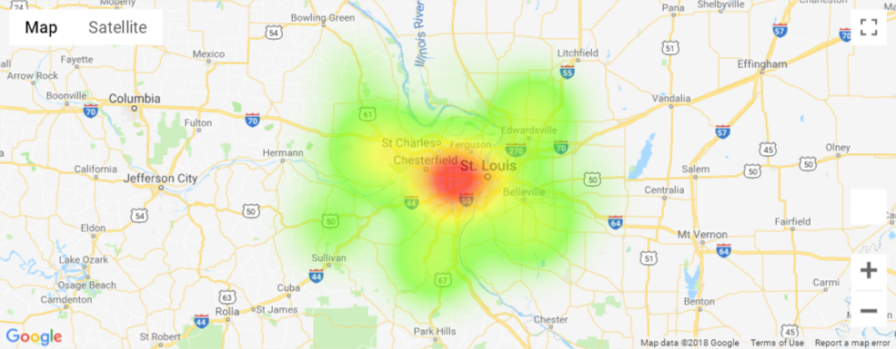
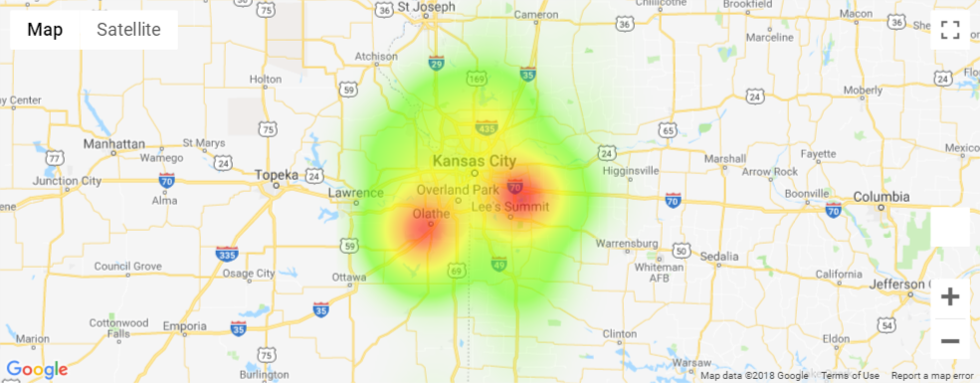
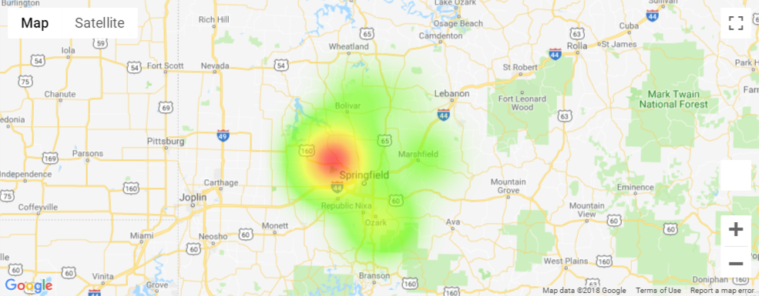
Data Analysis: MSA Comparisons - Commuter Concentrations

Slide 7
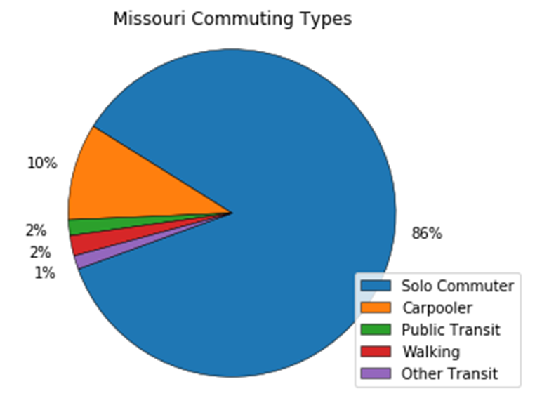
Data Analysis: Statewide
As expected, a massive majority of Missouri commuters are “Solo Commuters”
Commuter proportions very similar county to county. Highest numbers of commuters located in Kansas City, St. Louis and along I-44.
A very small amount of commuters represented who use public transit, walk or are listed as using “other transit”.
We love our cars!

Slide 8
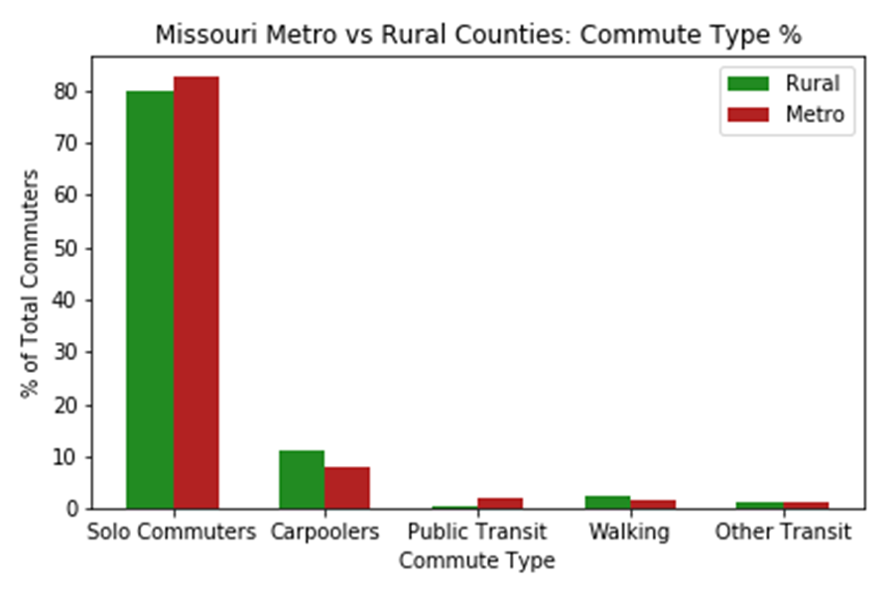
Data Analysis: Urban vs. Rural
Not a very significant level of difference.
By conducting an Independent T-Test it was found that rural areas do have a decently higher amount of carpoolers and walking commuters.
This could be due to people living in closer proximity to their place of work in rural areas.

Slide 9
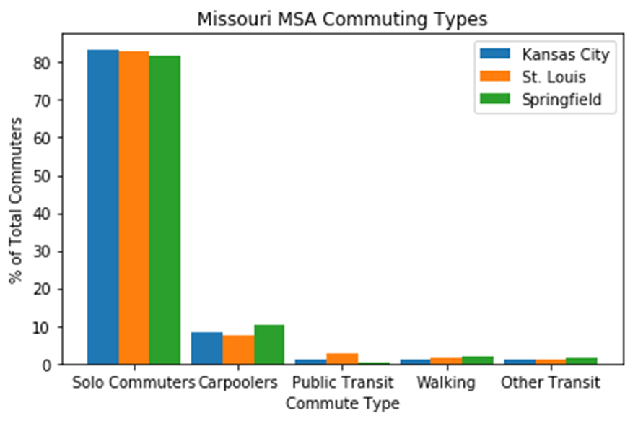
Data Analysis: Metro vs. Metro
An ANOVA test revealed significant differences for commute types % between the cities.
A T-Test showed Carpooler % between Kansas City and St. Louis to be significant
Visually notable differences include amount of carpoolers and amount of walking commuters in Springfield.
Could be due to higher percentage of people living near their place of work (i.e. a college campus, manufacturing facility, medical complex).

Slide 10
Discussion
Results were surprising, but not unexpected
We expected
More significant differences between urban/rural commuting types
A difference in commuting types between metro areas
That public transit was used more
Inferences or general conclusions?
Driving to work alone is considered the best commuting option.
Commuting options other than solo driving are limited statewide.
Public transit options exist almost exclusively in urban areas.
Even where available, public transit is not significantly used.

Slide 11
Post Mortem
Discuss any difficulties that arose, and how you dealt with them
Discuss any additional questions that came up, but which you didn't have time to answer: What would you research next, if you had two more weeks?
Analysis of other State’s commuting data to look for similarities/differences, specifically those in different geographies, with urban/rural ratio, larger metros
Additional analysis into Income Levels and Commuting Types.
Why are we seeing concentrations of Walkers in northern Missouri?

Slide 12
Questions?

Slide 14
Definition of Commuting
Census surveys define Commuting (Journey to Work) as “a worker’s travel from home to work”.
Census surveys ask questions about Commuting such as travel time, means of transportation, time of departure for work, vehicles available, and expenses associated with the commute.
For this analysis we looked only at means of transportation

Slide 15

Statewide Analysis

Slide 16
Heat Maps of MO MSAs

Slide 17
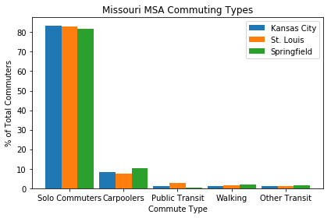
MSA Analysis

Slide 18
Hypotheses
H₀ ₌ No differences exist between commuting types in metro versus rural counties across Missouri.
H₁ = Differences exist between commuting types in metro versus rural counties across Missouri, where usage of public transit in metro counties is higher.

Slide 19
What we wanted to understand
How do Missourians commute?
What differences exist for commuting types across counties in Missouri?
What differences exist for commuting types within metropolitan areas in Missouri?

Slide 20
MSAs Analyzed
St. Louis
St. Louis City, MO
St. Louis County, MO
St. Charles County, MO
Jefferson County, MO
Franklin County, MO
Lincoln County, MO
Warren County, MO
Madison County, IL
St. Clair County, IL
Clinton County, IL
Monroe County, IL
Jersey County, IL
Kansas City
Bates County, MO
Caldwell County, MO
Cass County, MO
Clay County, MO
Clinton County, MO
Jackson County, MO
Lafayette County, MO
Platte County, MO
Ray County, MO
Johnson County, KS
Leavenworth County, KS
Linn County, KS
Miami County, KS
Wyandotte County, KS
Springfield
Greene County, MO
Christian County, MO
Webster County, MO
Polk County, MO
Dallas County, MO

Slide 22
Solo Commuters

Slide 23
Carpoolers

Slide 24
Public Transit

Slide 25
Walking

Slide 26

Other Transit

